Slide 1
Detection of emotion of a person based on social interactions on different social media
Under the guidance of
Dr. T. Ramakrishnudu
Team Members:
T Himasri(147154)
G Venu gopal(147118)
T Kavya Manjusha(147125)

Slide 2
ABSTRACT
Many Health problems like head ache, extreme tiredness, high blood pressure, Heart attack are highly related to emotional status of a person.
Therefore it is very important to detect the emotional status or emotions (Sadness, anger, fear etc.) of a person especially stress and anger.
Now-a-days people are using social media like facebook, twitter for social interactions.
Many people are showing more interests to express their views, opinions, thoughts, and activities in the social media making it feasible for the usage of these platforms for detecting emotional status of people.

Slide 3
Social Networks
• >1000 million users
• Most visited social networking site in the world
• More visitors than Google
2010, 2 billion tweets per quarter
• 2013, 4 billion tweets per quarter
• 2016, 25 billion tweets per quarter
Social networks already become a bridge to connect our daily physical life and the virtual web space.

Slide 4
PROBLEM STATEMENT
In this project, we would like to explore to automatically detect different types of emotions or emotional status of person via social media.
There are other methods to find emotions using physiological devices, image processing and personal interviews etc. But they are complicated and costly.
Hence , we address the problem of “Detecting emotion of a person based on social interactions on different social media”.

Slide 5
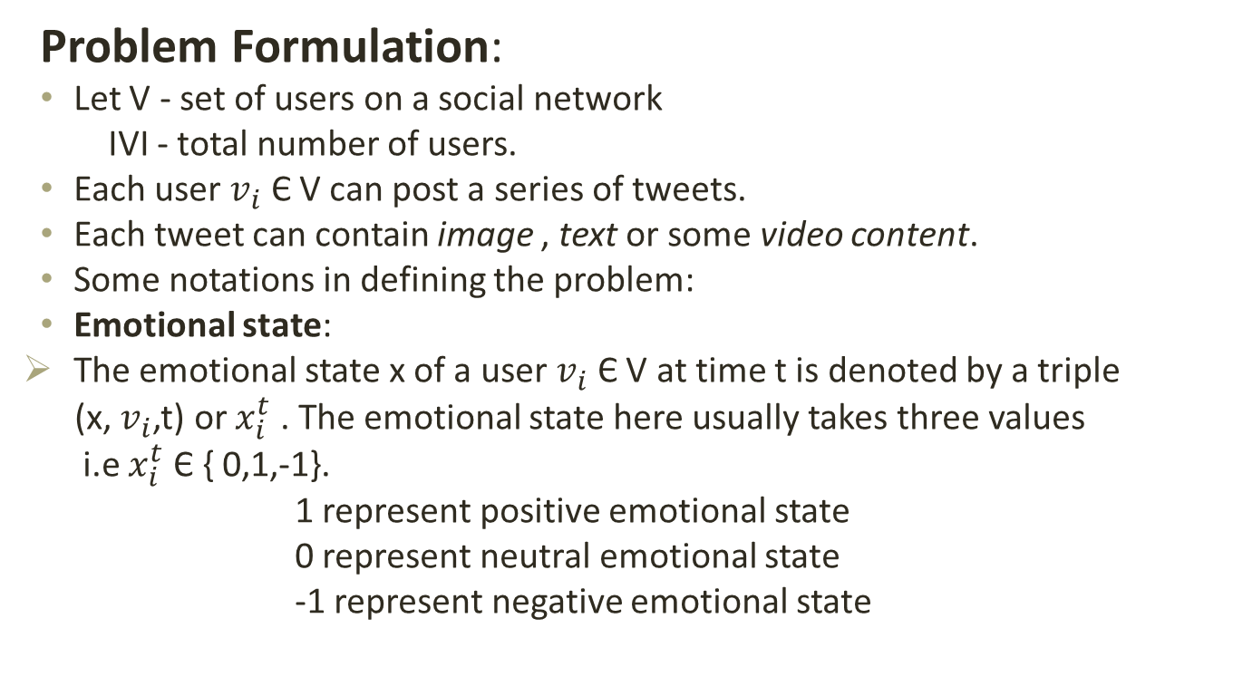
PROBLEM STATEMENT(Contd.)
Problem Formulation:
Let V - set of users on a social network
IVI - total number of users.
Each user $v_{i}$Є V can post a series of tweets.
Each tweet can contain image , text or some video content.
Some notations in defining the problem:
Emotional state:
The emotional state x of a user $v_{i}$ Є V at time t is denoted by a triple
(x, $v_{i}$,t) or $x_{i}^{t}$ . The emotional state here usually takes three values
i.e$x_{i}^{t}$ Є { 0,1,-1}.
1 represent positive emotional state
0 represent neutral emotional state
-1 represent negative emotional state

Slide 6
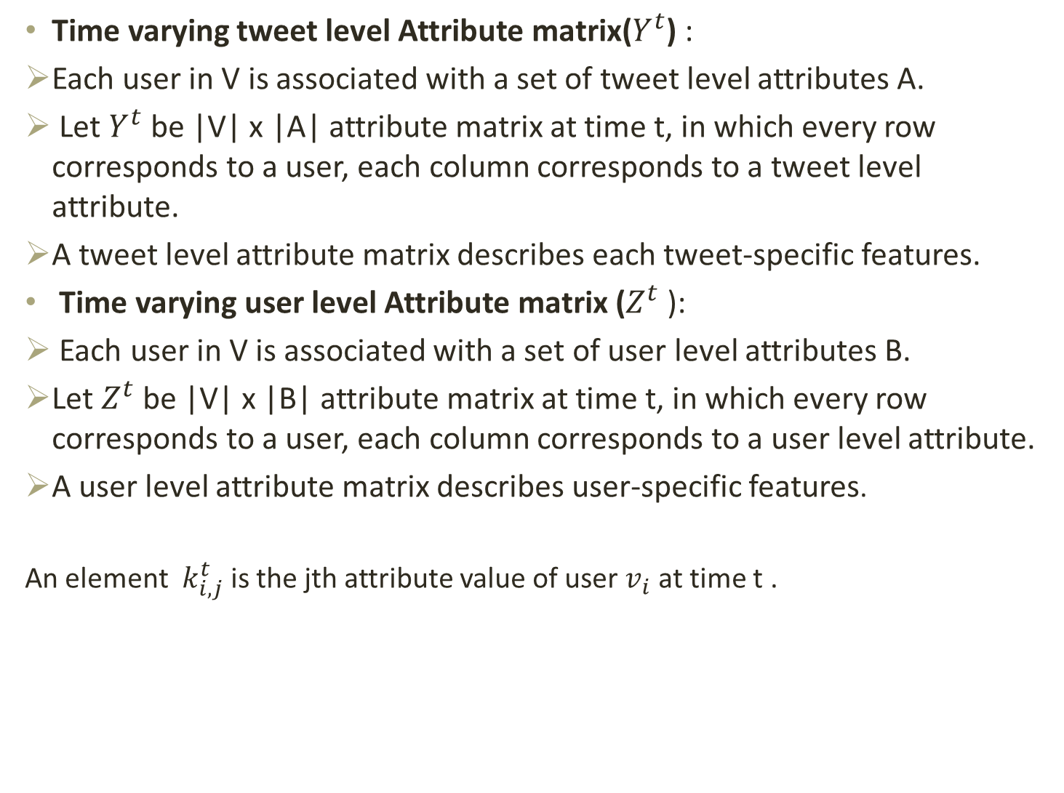
Time varying tweet level Attribute matrix($Y^{t}$) :
Each user in V is associated with a set of tweet level attributes A.
Let $Y^{t}$ be |V| x |A| attribute matrix at time t, in which every row corresponds to a user, each column corresponds to a tweet level attribute.
A tweet level attribute matrix describes each tweet-specific features.
Time varying user level Attribute matrix ($Z^{t}$):
Each user in V is associated with a set of user level attributes B.
Let $Z^{t}$ be |V| x |B| attribute matrix at time t, in which every row corresponds to a user, each column corresponds to a user level attribute.
A user level attribute matrix describes user-specific features.
An element $k_{i,j}^{t}$ is the jth attribute value of user $v_{i}$ at time t .

Slide 7
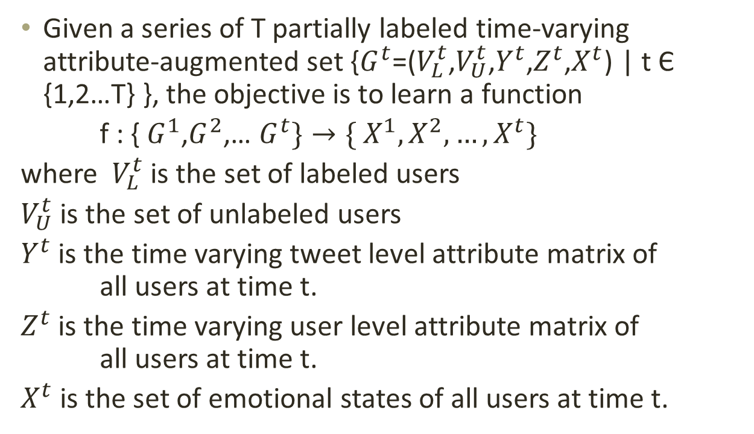
PROBLEM STATEMENT (Contd.)
Given a series of T partially labeled time-varying attribute-augmented set {$G^{t}$=($V_{L}^{t}$,$V_{U}^{t}$,$Y^{t}$,$Z^{t}$,$X^{t}$) | t Є {1,2…T} }, the objective is to learn a function
f : { $G^{1}$,$G^{2}$,… $G^{t}\}→\{ X^{1},X^{2},…, X^{t}\}$
where $V_{L }^{t}$is the set of labeled users
$V_{U}^{t}$ is the set of unlabeled users
$Y^{t}$ is the time varying tweet level attribute matrix of all users at time t.
$Z^{t}$ is the time varying user level attribute matrix of all users at time t.
$X^{t}$is the set of emotional states of all users at time t.

Slide 8
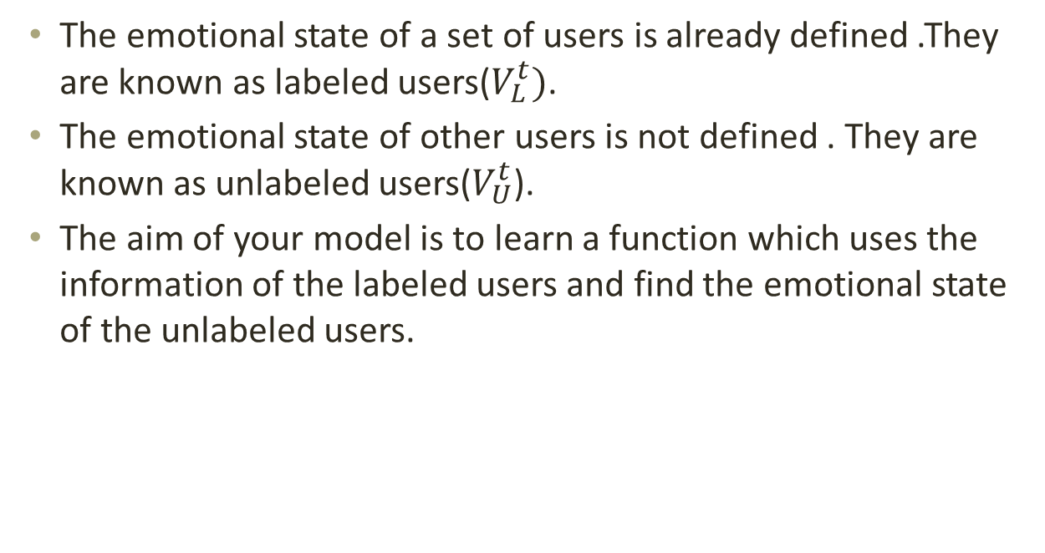
The emotional state of a set of users is already defined .They are known as labeled users($V_{L}^{t})$.
The emotional state of other users is not defined . They are known as unlabeled users($V_{U}^{t}$).
The aim of your model is to learn a function which uses the information of the labeled users and find the emotional state of the unlabeled users.

Slide 9
ATTRIBUTES CATEGORIZATION
In order to take advantage of both content information present in single micro-blog tweet and the statistical information from the tweets in sampling period , two sets of attributes are defined.
Tweet level attributes
User level attributes
1) Tweet level attributes : Describe about the contents of a single tweet. Textual, pictorial and social attributes are defined from each part of a tweet.

Slide 10
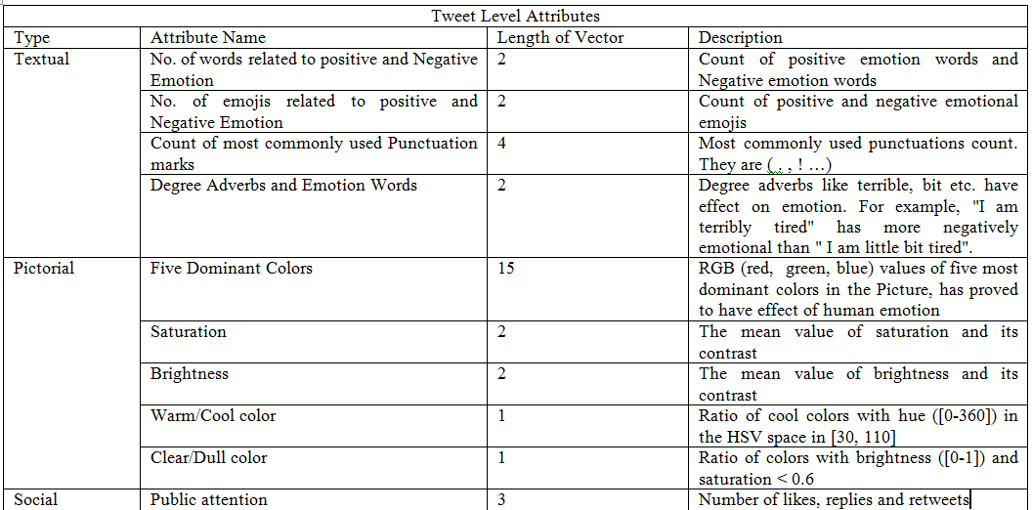
2) User level attributes:
User level attributes are summarized from users’ tweets.

Slide 11
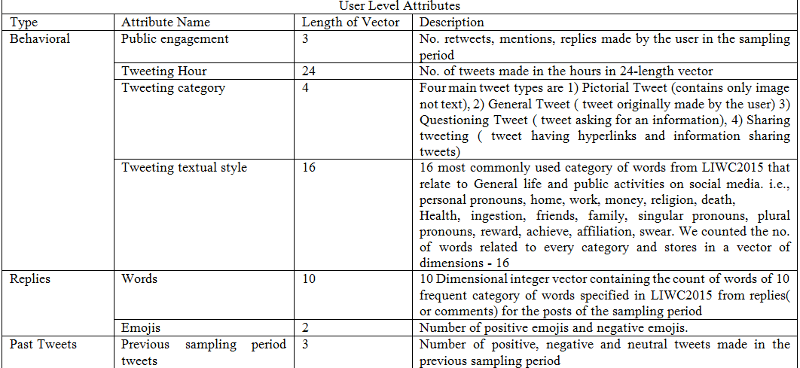

Slide 12
FORMAL MODEL
There are several challenges exist in emotional state detection:
1) Attributes in a tweet come with multiple modalities and the some of the components/modalities may be missing .
solution: a convolutional neural network with cross auto encoders to fill these missing modalities.
2) It is very difficult to label the data manually.
solution: using the sentence pattern “I feel stressed/ sad/ happy/ joy” etc. as the ground-truth label for detecting emotional state from social media data.

Slide 13
3)Detecting emotion in user-level is more tedious than in discrete tweet-level, since both the overview and detailed attributes should be concerned about.
solution: We propose an emotion detection model based on SVM to include the tweet level attributes and user level attributes together.

Slide 14
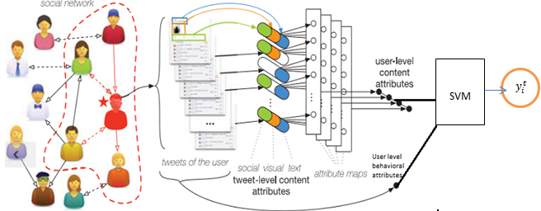

ARCHITECTURE
$$x_{i}^{t}$$
Emotional state
CNN
The model consists of two parts
Convolutional Neural Network (CNN) to fill the missing modalities in the tweets with the help of Cross Auto Encoders (CAE).
Support Vector Machines(SVM) to categorize and analyse the emotional state of the user

Slide 15
CROSS AUTO ENCODERS(CAE)
The basic idea of CAE is to force the model to reconstruct missing modalities in the training stage and to learn modalities correlation from the data.
While training the cross auto-encoder, we use training data which includes all the three modalities such as textual, pictorial and social interaction attributes.
We disable the visual or social interaction modalities manually and give this data to the CAE.
We then require the model to reconstruct all the three modalities

Slide 16
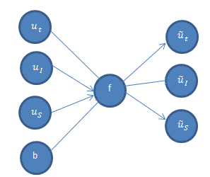
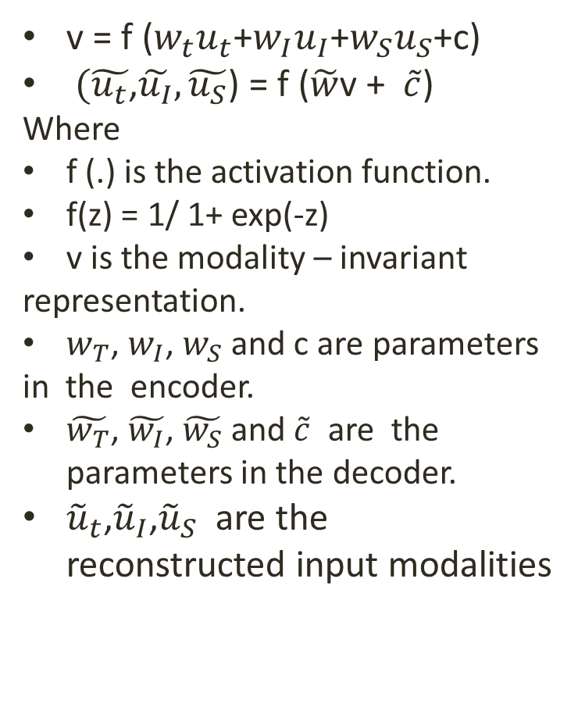
Formulation of Cross Auto encoders :
v = f ($w_{t}u_{t}$+$w_{I}u_{I}$+$w_{S}u_{S}$+c)
$(\tilde{u_{t}}$,$\tilde{u_{I}},\tilde{u_{S}}$) = f ($\tilde{w}$v + $\tilde{c}$)
Where
f (.) is the activation function.
f(z) = 1/ 1+ exp(-z)
v is the modality – invariant
representation.
$w_{T}$, $w_{I}$, $w_{S}$ and c are parameters
in the encoder.
$\tilde{w_{T}}$, $\tilde{w_{I}}$, $\tilde{w_{S}}$ and $\tilde{c}$ are the parameters in the decoder.
${\tilde{u}}_{t}$,${\tilde{u}}_{I}$,${\tilde{u}}_{S}$ are the reconstructed input modalities
Sample fig. of Cross Auto encoders here

Slide 17
SUPPORT VECTOR MACHINES
A support vector machine is a distinguishable classifier formally defined by a separating hyper plane.
In other words, when we give a labeled training data , the model outputs an efficient hyper plane which makes new examples given into categories.
When two categories of data or two sets of data points are given , SVM determines a hyper plane that separates these two categories.
The pooled attributes from the CAE units are given as input
to SVM.

Slide 18
IMPLEMENTATION
Data Pre-Processing:
For data pre-processing, first extracted raw tweets data from twitter. Secondly, preprocessed the data and extracted the features from the raw tweets.
Data labeling:
We labeled the tweets as positive tweet (1), negative tweet(-1) and neutral tweets(0) based on the common sentence patterns that expresses the emotion of a person such as “I feel sad”, “I feel happy”, “ I feel stressed”, “I am feeling better” etc.
Now data is available for feature extraction, analysis, further processing.

Slide 19
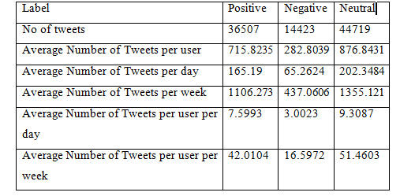
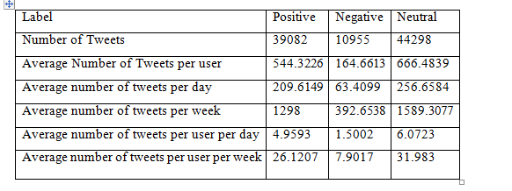
Datasets Collection:
Dataset 1: Dataset2:
Dataset 1: We have collected 51 users tweet data from 01.2018 to 03.2018
Dataset2 : We have collected 62 users tweet data from 11.2017 to 02.2018

Slide 20
Feature extraction:
Textual Features: Features related to tweet text are extracted based on the LIWC dictionary.
Pictorial Features: Features related to images are extracted using opencv library for python.
Features related to behavior, public attention, replies are directly extracted from tweets itself.
We have added some additional attributes to the existing attributes in order to detect the emotion of a person accurately.

Slide 21
OBSERVATION AND ANALYSIS
Effect of replies on the emotional state
Effect of past tweets on the present emotional state of a person

Slide 22
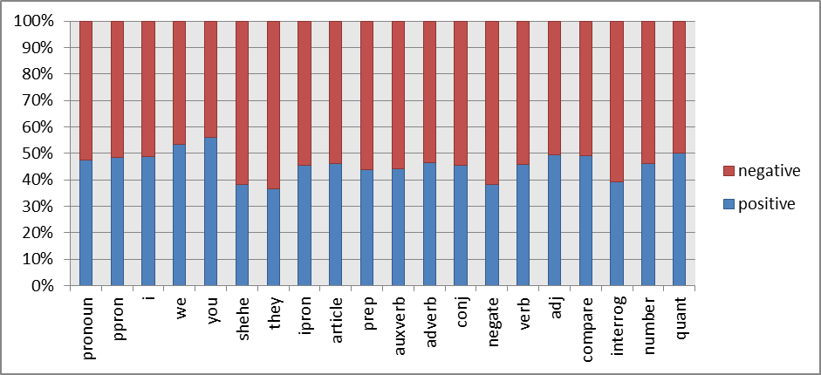
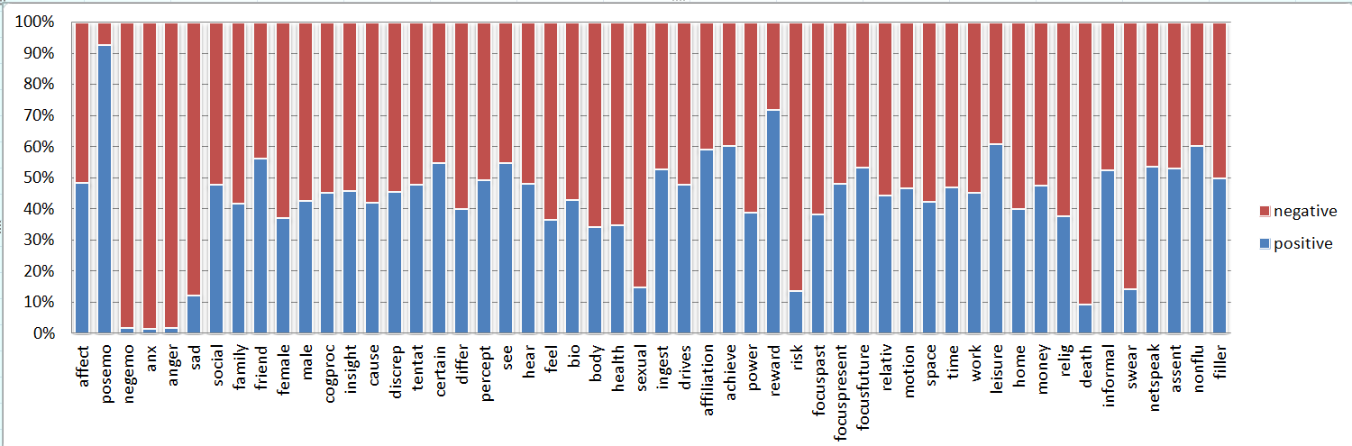
Effect of tweeting textual style on the emotional state
Effect of some of the most commonly
used word categories :

Slide 23
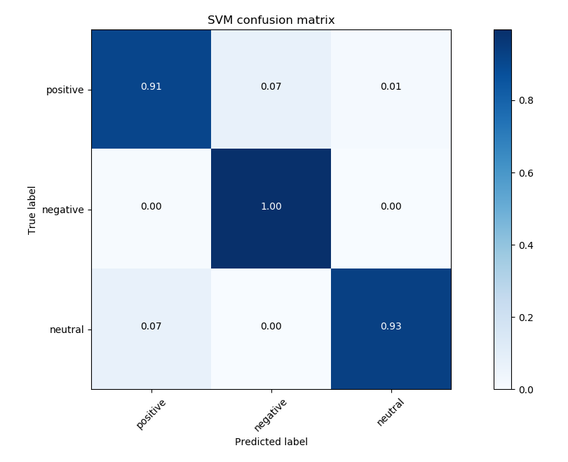
RESULTS ANALYSIS
A confusion matrix is a table that is often used to describe the performance of a classification model on a set of test data for which the true values are known.
The Confusion matrix for SVM is shown below.

Slide 24
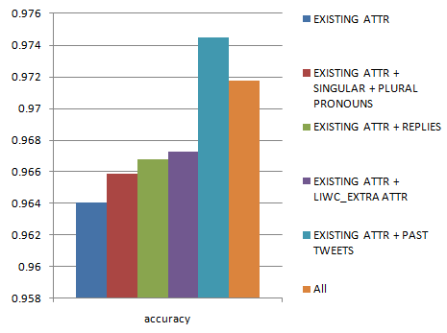
RESULTS ANALYSIS(Contd.)
An accuracy graph is made to analyse the working of the model upon the addition of new attributes .
It has been observed that the addition of past tweets attribute results in the higher accuracy in detecting the emotional state.

Slide 25
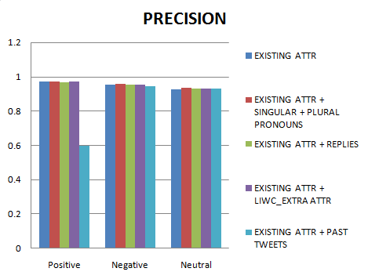
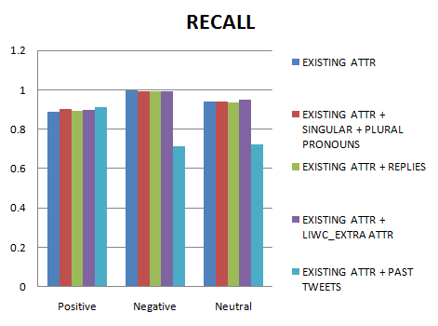
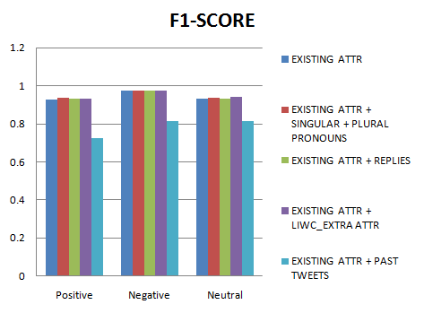
The precision and recall are basically used to determine the relevance.
The precision, recall, f1-score graph are given below.

Slide 26
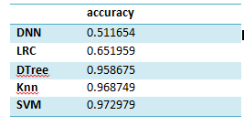
COMPARISION RESULTS
To determine the efficiency of our model , we have compared our model with various other machine learning techniques.
It has been observed that our proposed model is effective and efficient in detecting the emotion of a person based on social media data.

Slide 27
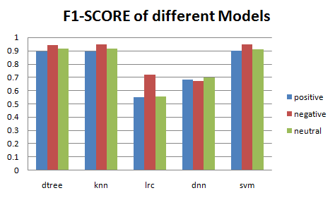
F1- score is usually a measure of test’s accuracy.
F1-score obtained by the comparision of various models is shown below.

Slide 28
CONCLUSION
We have developed a model based on Cross Auto Encoders(CAE) and Support Vector Machines(SVM) to detect the emotional state of a person based on the social interactions in the social media.
We have discovered some new attributes which have a significant effect on the emotional state detection.
We have also compared our model with the other machine learning models such as K nearest neighbours(KNN),Logistic Regression(LR), Decision Tree (dtree) etc.
Finally , the results obtained showed us that the proposed model is effective and efficient on detecting emotional state of user from micro-blog data.

Slide 29
REFERENCES
IEEE Transactions On Knowledge And Data Engineering, Vol. 29, No. 9
“Detecting Stress Based on social interactions on social media”.
A. Bogomolov, B. Lepri, M. Ferron, F. Pianesi, and A. Pentland, “Daily stress recognition from mobile phone data, weather conditions and individual traits,” in Proc. ACM Int. Conf. Multimedia, 2014, pp. 477–486.
G. Coppersmith, C. Harman, and M. Dredze, “Measuring post traumatic stress disorder in twitter,” in Proc. Int. Conf. Weblogs Soc. Media, 2014, pp. 579–582.
J. Zhao, L. Dong, J. Wu, and K. Xu, “Moodlens: An emoticonbased sentiment analysis system for chinese Tweets,” in Proc. 18th ACM SIGKDD Int. Conf. Knowl. Discovery Data Mining, 2012, pp. 1528–1531

Slide 30


